Slide 1
SMART VOTERS
TEAM MEMBERS FACULTY GUIDE
Bhalaji.K Suganthi.A
Madhan Kumar.R INDUSTRY GUIDE
Gowsalya.M Yukthika
Jayadurai.C

Slide 2
The main goal and objective of this Smart Voting System application are to help the organization in automating the entire manual process of the existing voting system. The voting system must be compatible with the multiuser environment. The Smart Voting System should be able to follow the entire detailed description of candidates and Voters.
ABSTRACT

Slide 3
In India, voting is been done only in booths arranged by the Election Commission.
EXISTING SYSTEM

Slide 4
1. An Online Voting System developed to vote in a simple & more efficient way. 2.To avoid crowd in voting booths. 3.Useful for the citizens staying abroad & other states & cities of the country. 4.Easily used by the aged people.
PROPOSED SYSTEM

Slide 5
DRAWBACKS OF EXISTING SYSTEM - Fake votes can be done. - Standing in queue for a long time. - Brainwashing for unwilling candidate.

Slide 6
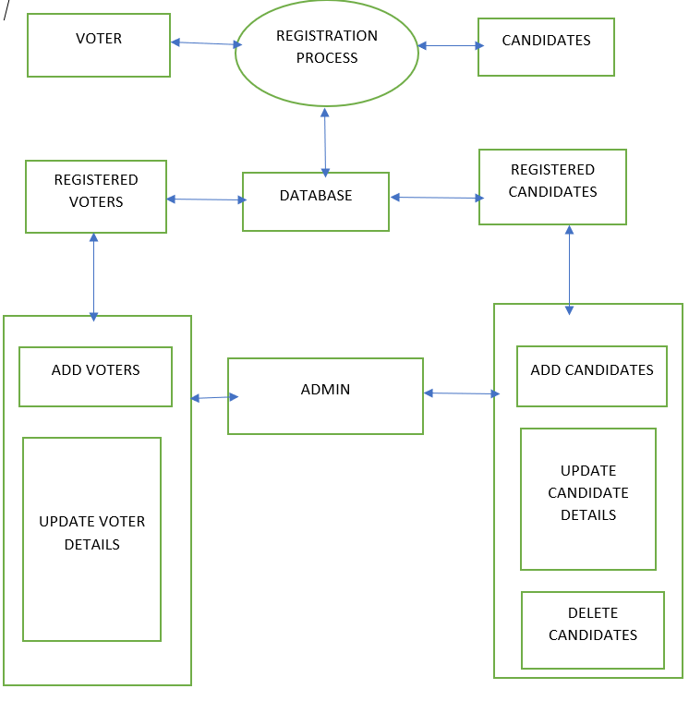
ARCHITECTURAL DESIGN

Slide 7
Username & password Status Status Username & password
DFD-LEVEL 0
Voters
Online Voting Sysytem
Admin

Slide 8
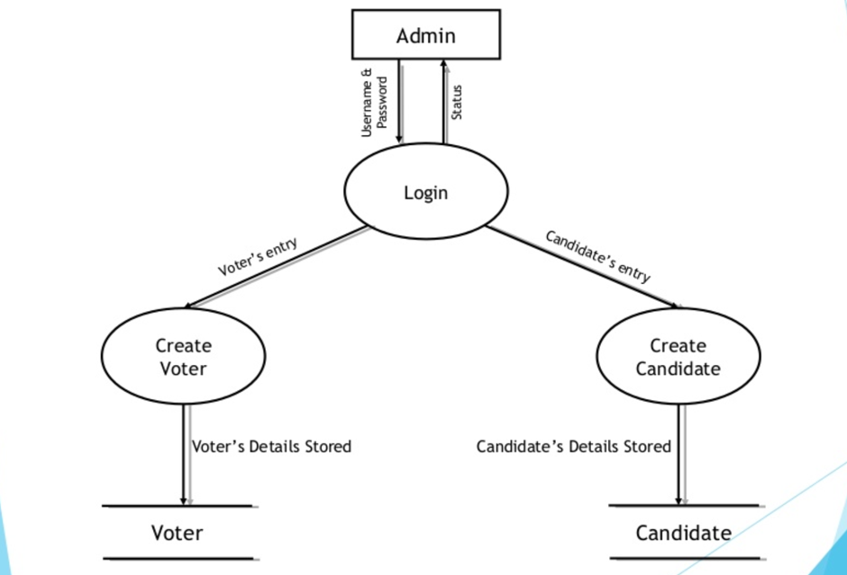
DFD-LEVEL1

Slide 9
Module 1 : Authorization Module 2 : User Profile Module 3 : Online Voting Module 4 : Notification
MODULE SPLITUP

Slide 10
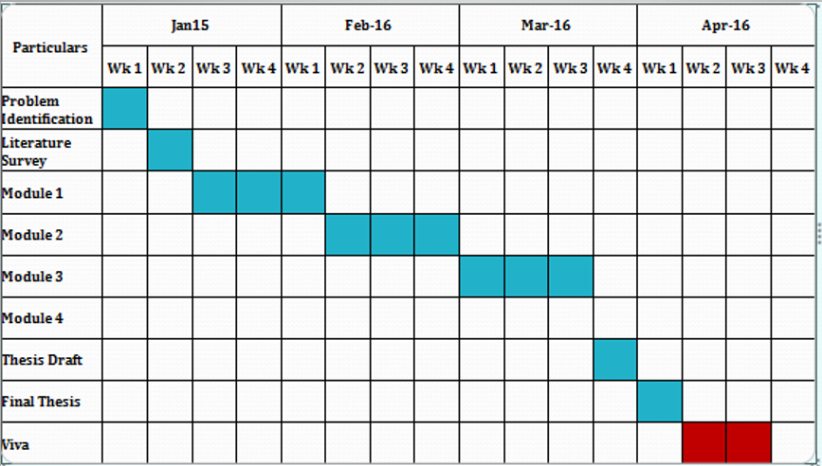
PROJECT PLANNER

Slide 11
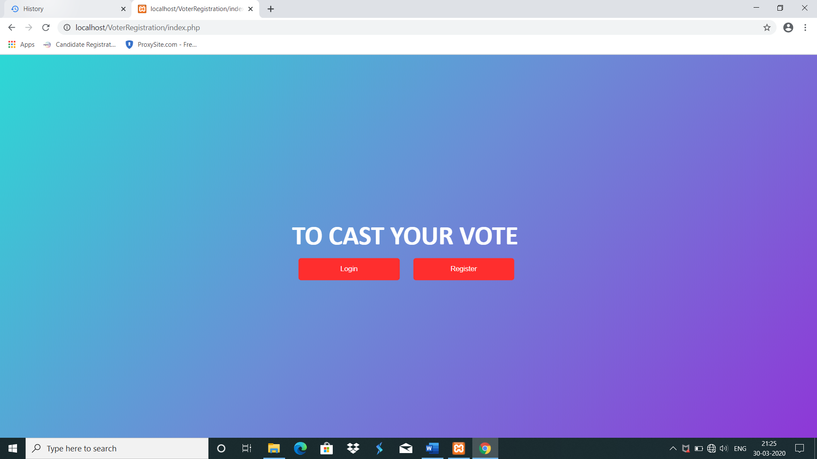
Home Page
SCREENSHOT OF OUR WORKING MODEL

Slide 12
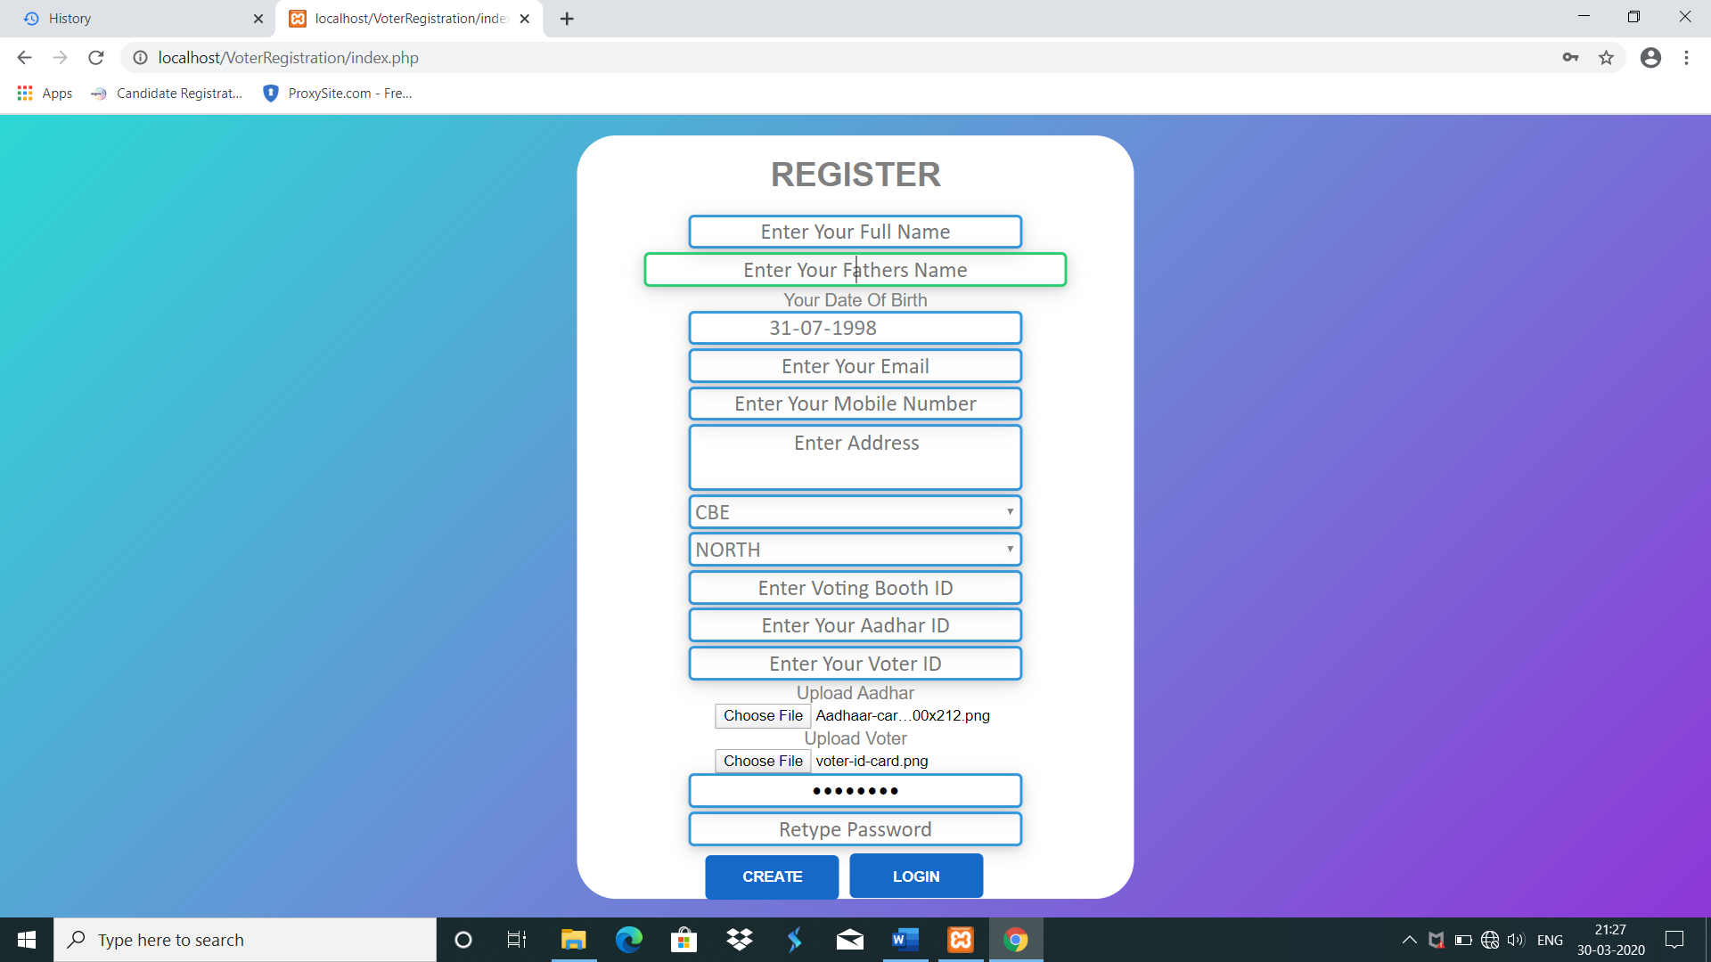
REGISTRATION PAGE

Slide 13
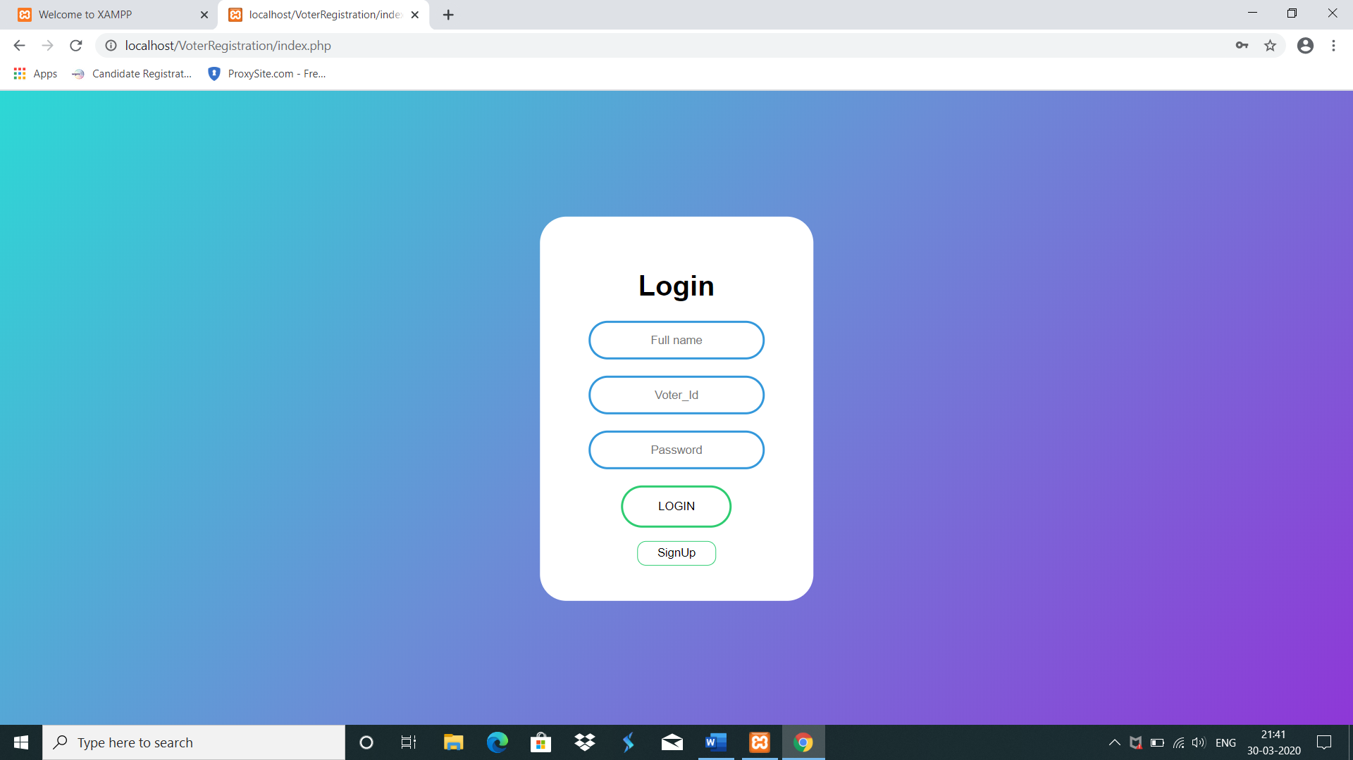
LOGIN PAGE

Slide 14
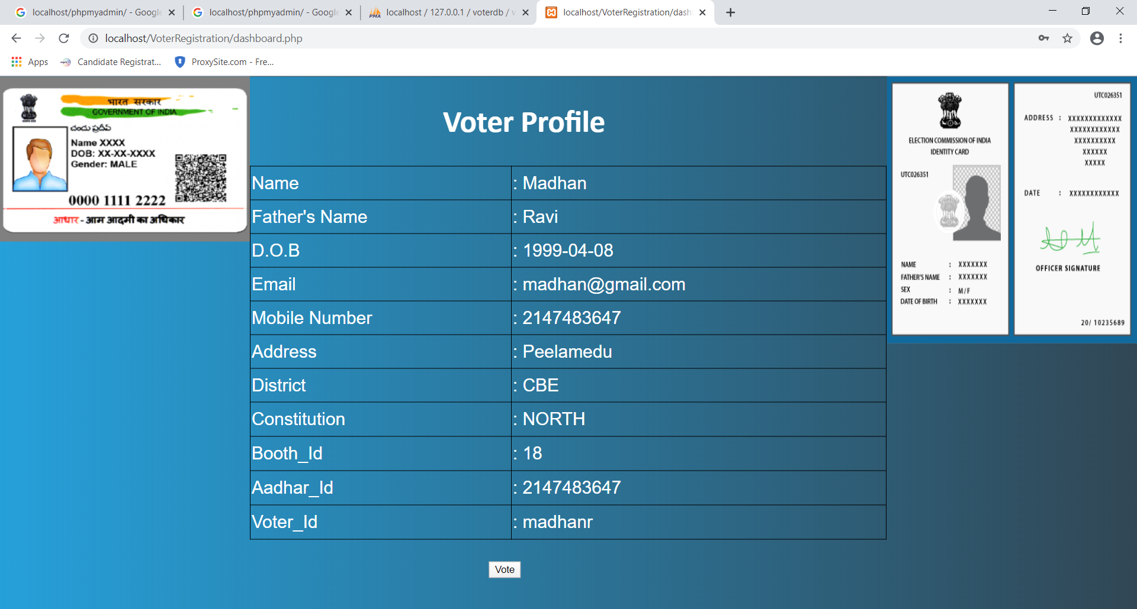
DATA VERIFICATION PAGE

Slide 15
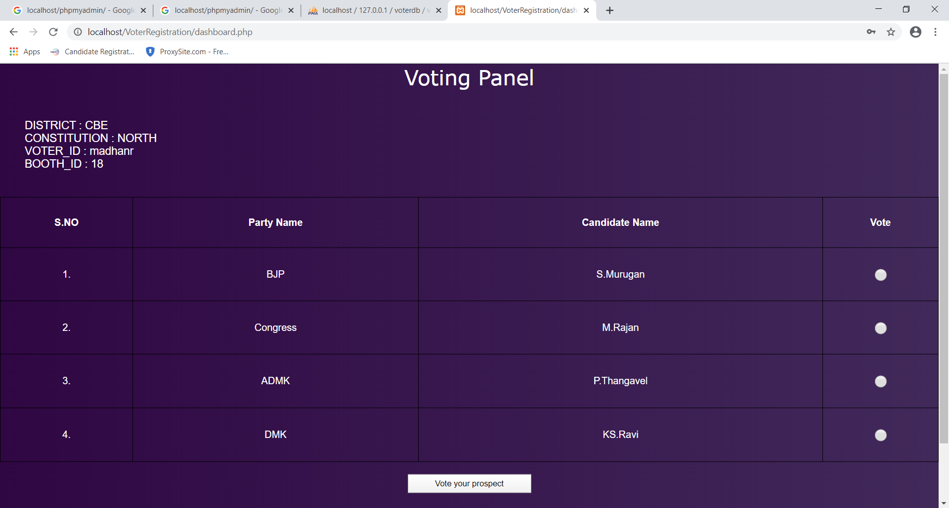
VOTING PANEL PAGE

Slide 16
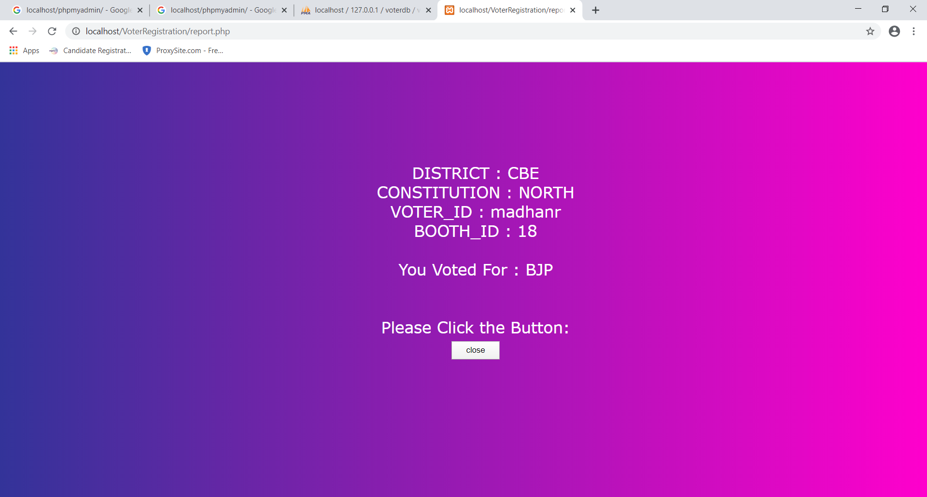
CONFIRMATION PAGE

Slide 17
CONCLUSION
Online voting technology has not yet reached a level where the benefits of online voting would be greater than its risks. From the technical point of view, it would be possible to implement an online voting system, but there are deficiencies in how the verifiability and the prevention of pressuring voters could be reconciled. In practice, voters would have to be able to ensure that their vote has been counted as cast, but the system should still not produce a receipt that could be used to pressure voters or sell votes.

Slide 18
REFERENCE
-https://1000projects.org/smart-voting-system-php-website-android-app.html -https://ieeexplore.ieee.org/document/6756265 -https://www.eballot.com/votes-and-elections/what-is-an-online-voting-system

Slide 19
THANKYOU

